Slide 1
Managing Work Comp Claims during COVID-19
A live panel discussion
April 2020

Slide 2
Presentation Housekeeping
Worker’s Comp focus
Q&A to follow via email after webinar
Ask a question in Chat
Raise your hand

Slide 3
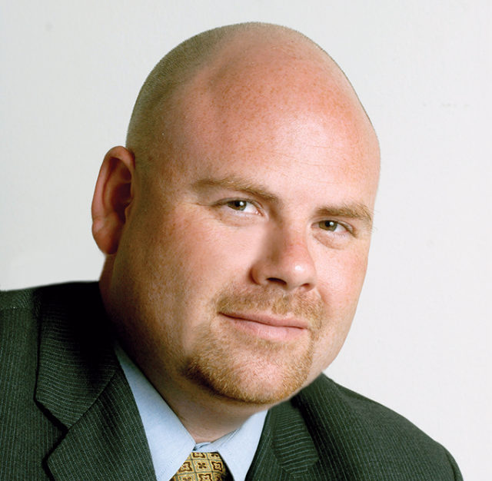
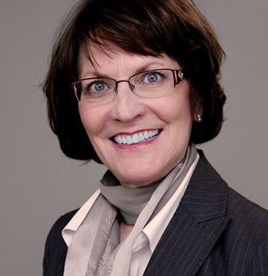
Joe Delucchi
President / CEO
CAL Insurance
Sharon poston ARM, SIP
President / Claims Mgr.
ESM INSITE
Sinead Scrosoppi
Customer Success
ESM INSITE
MODERATORS
Abe Jabhan JD
Sr. Claims Advocate
ESM INSITE
Khai Sim ARM, ARM-P, WCCP, AIM, CPCU, SIP,
Principal Claims Advocate
ESM INSITE
Saul Pazar MBA, SIP
Sr. Claims Advocate
ESM INSITE
Hailee Hansen SIP
Sr. Claims Advocate
ESM INSITE
PANEL

Slide 4
Q. What is telehealth or telemedicine? How can that help our business during the Covid-19 order to stay home?

Slide 5
Q. My employee is currently off work after a March surgery for a knee injury. He is recovering but his surgeon rescheduled his April appointment to May.
Will his Temporary Disability benefits be stopped? What can he do to get the necessary medical authorization for T.D.?

Slide 6
Q. My working employee has a minor elbow strain from lifting, but she does not want to go to the doctor during the Covid-19 exposure.
What can I do?

Slide 7
Q. Do you think this is a good time to try to settle existing cases?

Slide 8
Q. I have an open Workers’ Comp claim. Is there anything I can do to keep the case moving to resolution and closure?
Medical Status: The employee is MMI and the treater has just provided the permanent work restrictions.
Medical Legal Status: The injured employee’s QME appointment is scheduled for April 15, 2020, but the doctor has postponed the exam.
Employment Status: We conducted an interactive process with her and after our discussion, it was determined that we could not accommodate her permanent work restrictions following her back surgery.

Slide 9
Q. I have an open W.C. claim that all parties recently agreed to a Compromise and Release settlement amount, but now it seems stuck in limbo.
What can I do to get the claim closed?

Slide 10
Resources
ESM Blog:
Coronavirus Q&A: https://www.esminsite.com/blog/coronavirus-workers-compensation-claims-questions-answers
Exposure Control Plan: www.esminsite.com/blog/exposure-control-plan-coronavirus-preparation
Work From Home Ergo Exposures & Strategies: https://www.esminsite.com/blog/work-from-home-ergonomic-strategies

Slide 11
ESM INSITE
916.426.0500 | esminsite.com
LinkedIn | Newsletter
CAL Insurance
415.680.2124 | mycalteam.com
LinkedIn | Contact Us

