Slide 1
Your Return To Work Strategy Part 1
A Safety Reboot

Slide 2
Presentation Housekeeping
Worker’s Comp focus
Safety / Cal-OSHA compliance
Framework for risk management
Q&A to follow via email after webinar

Slide 3
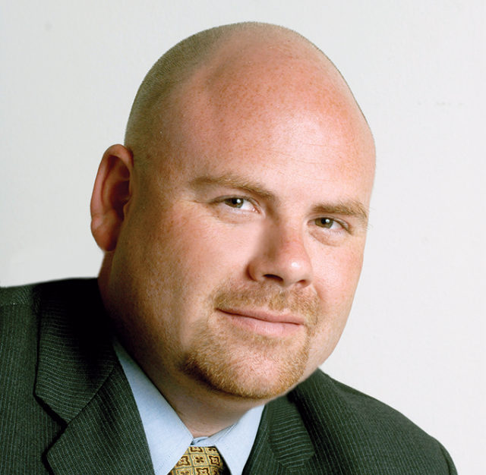
Joe Delucchi
President / CEO
CAL Insurance
Anthony Poston ARM, AIM
CEO / Risk Manager
ESM INSITE
Sinead Scrosoppi
Customer Success
ESM INSITE
PRESENTERS & CONTRIBUTORS
TEAMS

Slide 4
COVID-19: supporting our customer’s needs
PHASE 4: Return To Work (Re-entry)
PHASE 1: Exposure Control Plan
PHASE 2: Remote Work Program
PHASE 3: Managing Claims

Slide 5
“COVID-19 will be the largest event in insurance history” - Evan Greenberg
CEO, Chubb Insurance

Slide 6
California Update

Slide 7
4 Stages of reopening

Slide 8
WCIRB Recommended Amendments
To permit during a statewide California COVID-19 stay-at-home order:
(1) the division of an employee’s payroll between Classification 8810, Clerical Office Employees,
(2) payments made to an employee while the employee is performing no duties of any kind in service of the employer to be excluded from payroll when the payments are equal to or less than the employee’s regular rate of pay.
(3) COVID-19 claims will not impact the X-Mod

Slide 9
Premium = Payroll * Job Classification * Rate * X-Mod
Keep accurate payroll ledgers (office vs. Home vs. not working)
Keep a separate log of any COVID-19 claims submitted to your carrier

Slide 10
8810 Classification – what you need to know
Effective as of the date of a California statewide stay-at-home order and concluding sixty (60) days after the order is lifted, the payroll of an employee who meets the definition of a Clerical Office Employee, as detailed in Rule 4a, Clerical Office Employees, and whose payroll for the balance of the policy period is not assignable to a standard classification that specifically includes Clerical Office Employees, shall be assigned to Classification 8810, Clerical Office Employees.
A single employee’s payroll may be divided between Classification 8810 and another classification only once during this time period. Once the employee’s duties are no longer exclusively clerical in nature, Classification 8810 shall not be assigned.

Slide 11
Excluded Payroll – what you need to do
Effective as of the date of a California statewide stay-at-home order and concluding thirty (30) days after the order is lifted, payments made to an employee, including but not limited to sick or family leave payments, while the employee is performing no duties of any kind in service of the employer shall be excluded from remuneration; however, the excluded amounts shall be no greater than the employee’s regular rate of pay. This new class code will be 0012
Employers must maintain records that document the change in duties and that segregate such payments during the timeframes specified above.

Slide 12
COVID-19 Claims
Claims directly arising from a diagnosis of Coronavirus disease 2019 (COVID-19), reported with a Catastrophe Number 12 pursuant to the Uniform Statistical Reporting Plan, shall not be reflected in the computation of the experience modification (X-Mod).

Slide 13
Work Comp Renewal Questions
If impacted by the current environment, what is Insured’s business resiliency plan?
If Insured is considering impacts to the number in workforce, potentially through layoffs or furloughs, what steps is Insured taking during this transition?
Considering the current situation, are the payroll estimates provided still accurate?
What facility cleaning and employee protections, including Personal Protective Equipment is in place? If one or all of the facilities have been closed, what is the plan to re-open them (Include comments on cleanliness, electrical inspection and general re-start of idle equipment)?

Slide 14
Return To Work Challenges
Federal, State, and Local requirements vs. recommendations
Procedures change as State and Nation-wide data is analyzed
There is not a one-size-fits-all rule
Employee disciplines have been forgotten
New employees unfamiliar with your procedures, worksite, project

Slide 15
Construction – Large Project (Contra Costa)
Assign a COVID-19 Safety Compliance Officer (SCO)
Assign a COVID-19 3rd party Job Safety Accountability Supervisor (JSAS)
Develop a site-specific health and safety plan (including a spread reduction plan)
Provide PPE (gloves, googles, face shields, and face coverings)
Implement social distancing requirements (shift staggering, 6ft distance, control “choke points”, etc.)
Postings for minimize of spread (handwashing, face touching, etc.)
Cleaning & Sanitization practices
Confirmed case individual removal, decontamination protocols and County Public Health Department notification

Slide 16
Construction Resource: On-Site Health & Safety
Review site specific written plans
Temperature Screening
COVID-19 Testing (blood testing for antibodies)
Job Safety & Accountability Supervisor (JSAS)
Website: https://onsitehealthandsafety.com/
Dispatch phone: 866-998-2750

Slide 17
Re-Entry Preparation Checklist
Action Item | Examples
Establish a COVID-19 task force with defined roles and responsibilities for preparedness and response planning. | Name: Title: Safety Manager / COVID Coordinator Phone: Email:
Identify high risk individuals | People aged 65+. Chronic lung disease or asthma, serious heart conditions, severe obesity, pregnant, etc.
Move high-risk employees to areas with lower risk for COVID-19 exposures. Designate those areas for only high-risk employees | Cordon off areas for high risk individuals
Define PPE required by department and based on Very High to Low risk categories | Face coverings, gloves, googles
Establish physical distancing protocols for employees and customers | Floor markings, physical barriers
Daily health assessment established (at home and at work) | Temperature screening, symptom monitoring
Identify frequency of air filter replacement | Quarterly to monthly
Identify frequency of sanitization efforts by department | Common areas sanitize 3X a day, establish sanitization stations
Policies & Procedures to Review | Developed
Employee’s job description | ◻
Injury & Illness Prevention Program | ◻
Code of Safe Practices | ◻
Daily Health Assessment protocols | ◻
Social distancing protocols | ◻
General health and wellness training | ◻
Personal Protective Equipment requirements | ◻
Cleaning & Disinfection protocols | ◻
Department Job Safety Analysis or SOPs | ◻
Reconfiguration of worksite | ◻
General health and hygiene protocols | ◻

Slide 18
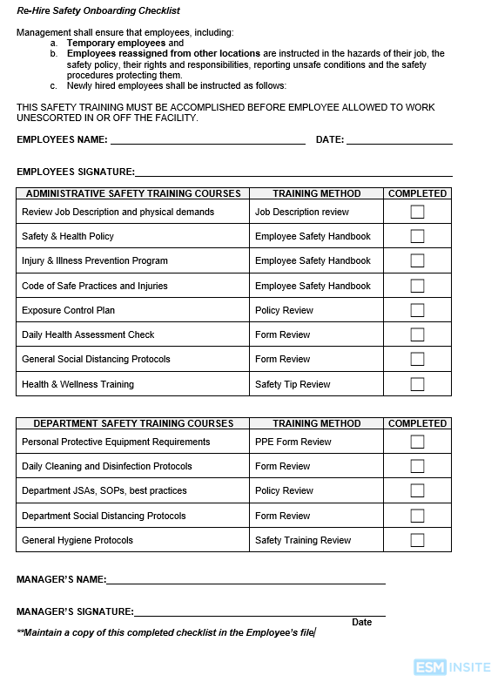
Re-Hire Onboarding Checklist
Fit for duty?
www.esminsite.com/s/ESM_Re-Hire-Safety-Orientaiton-Checklist.docx

Slide 19
Psychological hurdles
Leaving the safety of home
Overcoming anxiousness and depression from SIP
Mental reconditioning of work disciplines
Retraining of the mind and body
Make information on your Employee Assistance Program (EAP) readily available.

Slide 20
PART 2: A 6 Step Process to Re-Entry
Business Re-Entry Checklist
Exposure Control Plan
Worksite Cleaning Protocols
Social Distancing Protocols
Worksite Controls (Engineering, Administrative)
Re-Opening Strategy (6 points)
1
2
3
4
5
6
Date: Wednesday May 13th, 2020 at 10:30am PST
https://us02web.zoom.us/webinar/register/WN_gQLOVTqISVa4zeOEaiaoEw

Slide 21
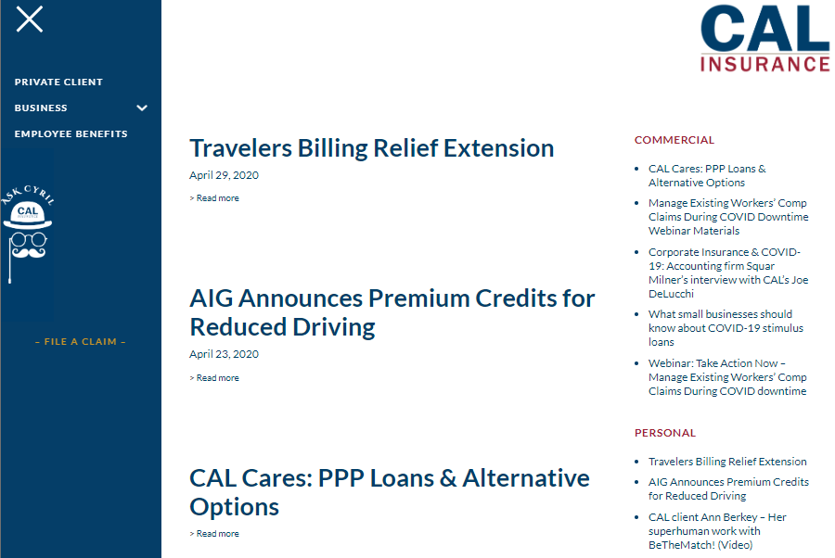
COVID Resources
https://mycalteam.com/news/
Phase 1: Exposure Control Plan
Policies
Training
Forms
Phase 2: Remote Work Program
Ergonomic policy
Remote Work Program
Forms
Training
Phase 3: Return To Work program
Policies
Training
forms
www.esminsite.com/covid-compliance-center

Slide 22
ESM INSITE
916.426.0500 | esminsite.com
LinkedIn | Newsletter
CAL Insurance
415.680.2124 | mycalteam.com
LinkedIn | Contact Us

